Slide 1
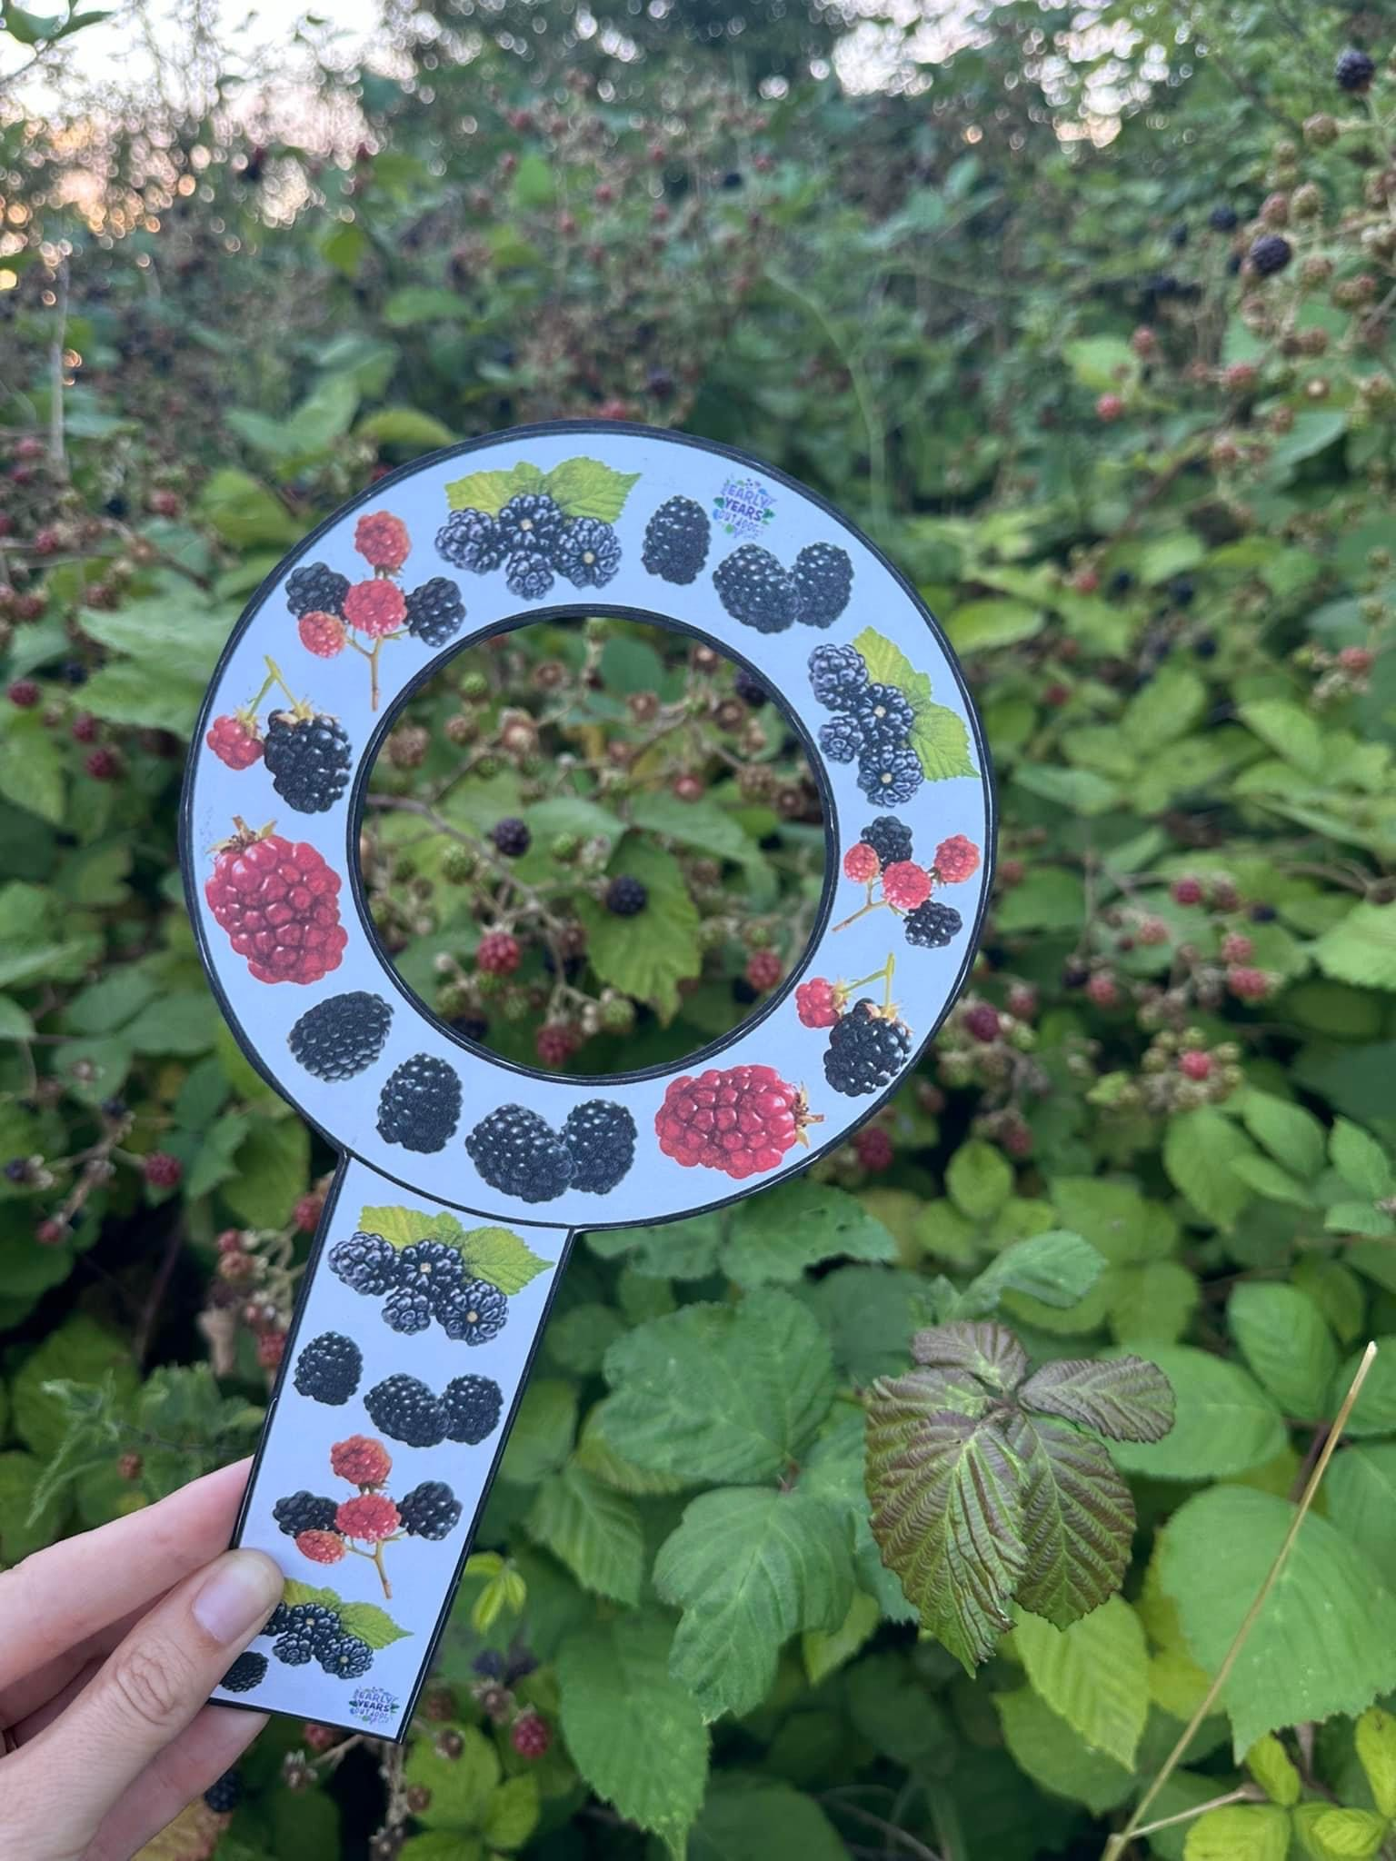
Forest Activity Day for Children
A fun-filled day in the forest for kids to learn, play, and create memories!
By Melissa C Main

Slide 2
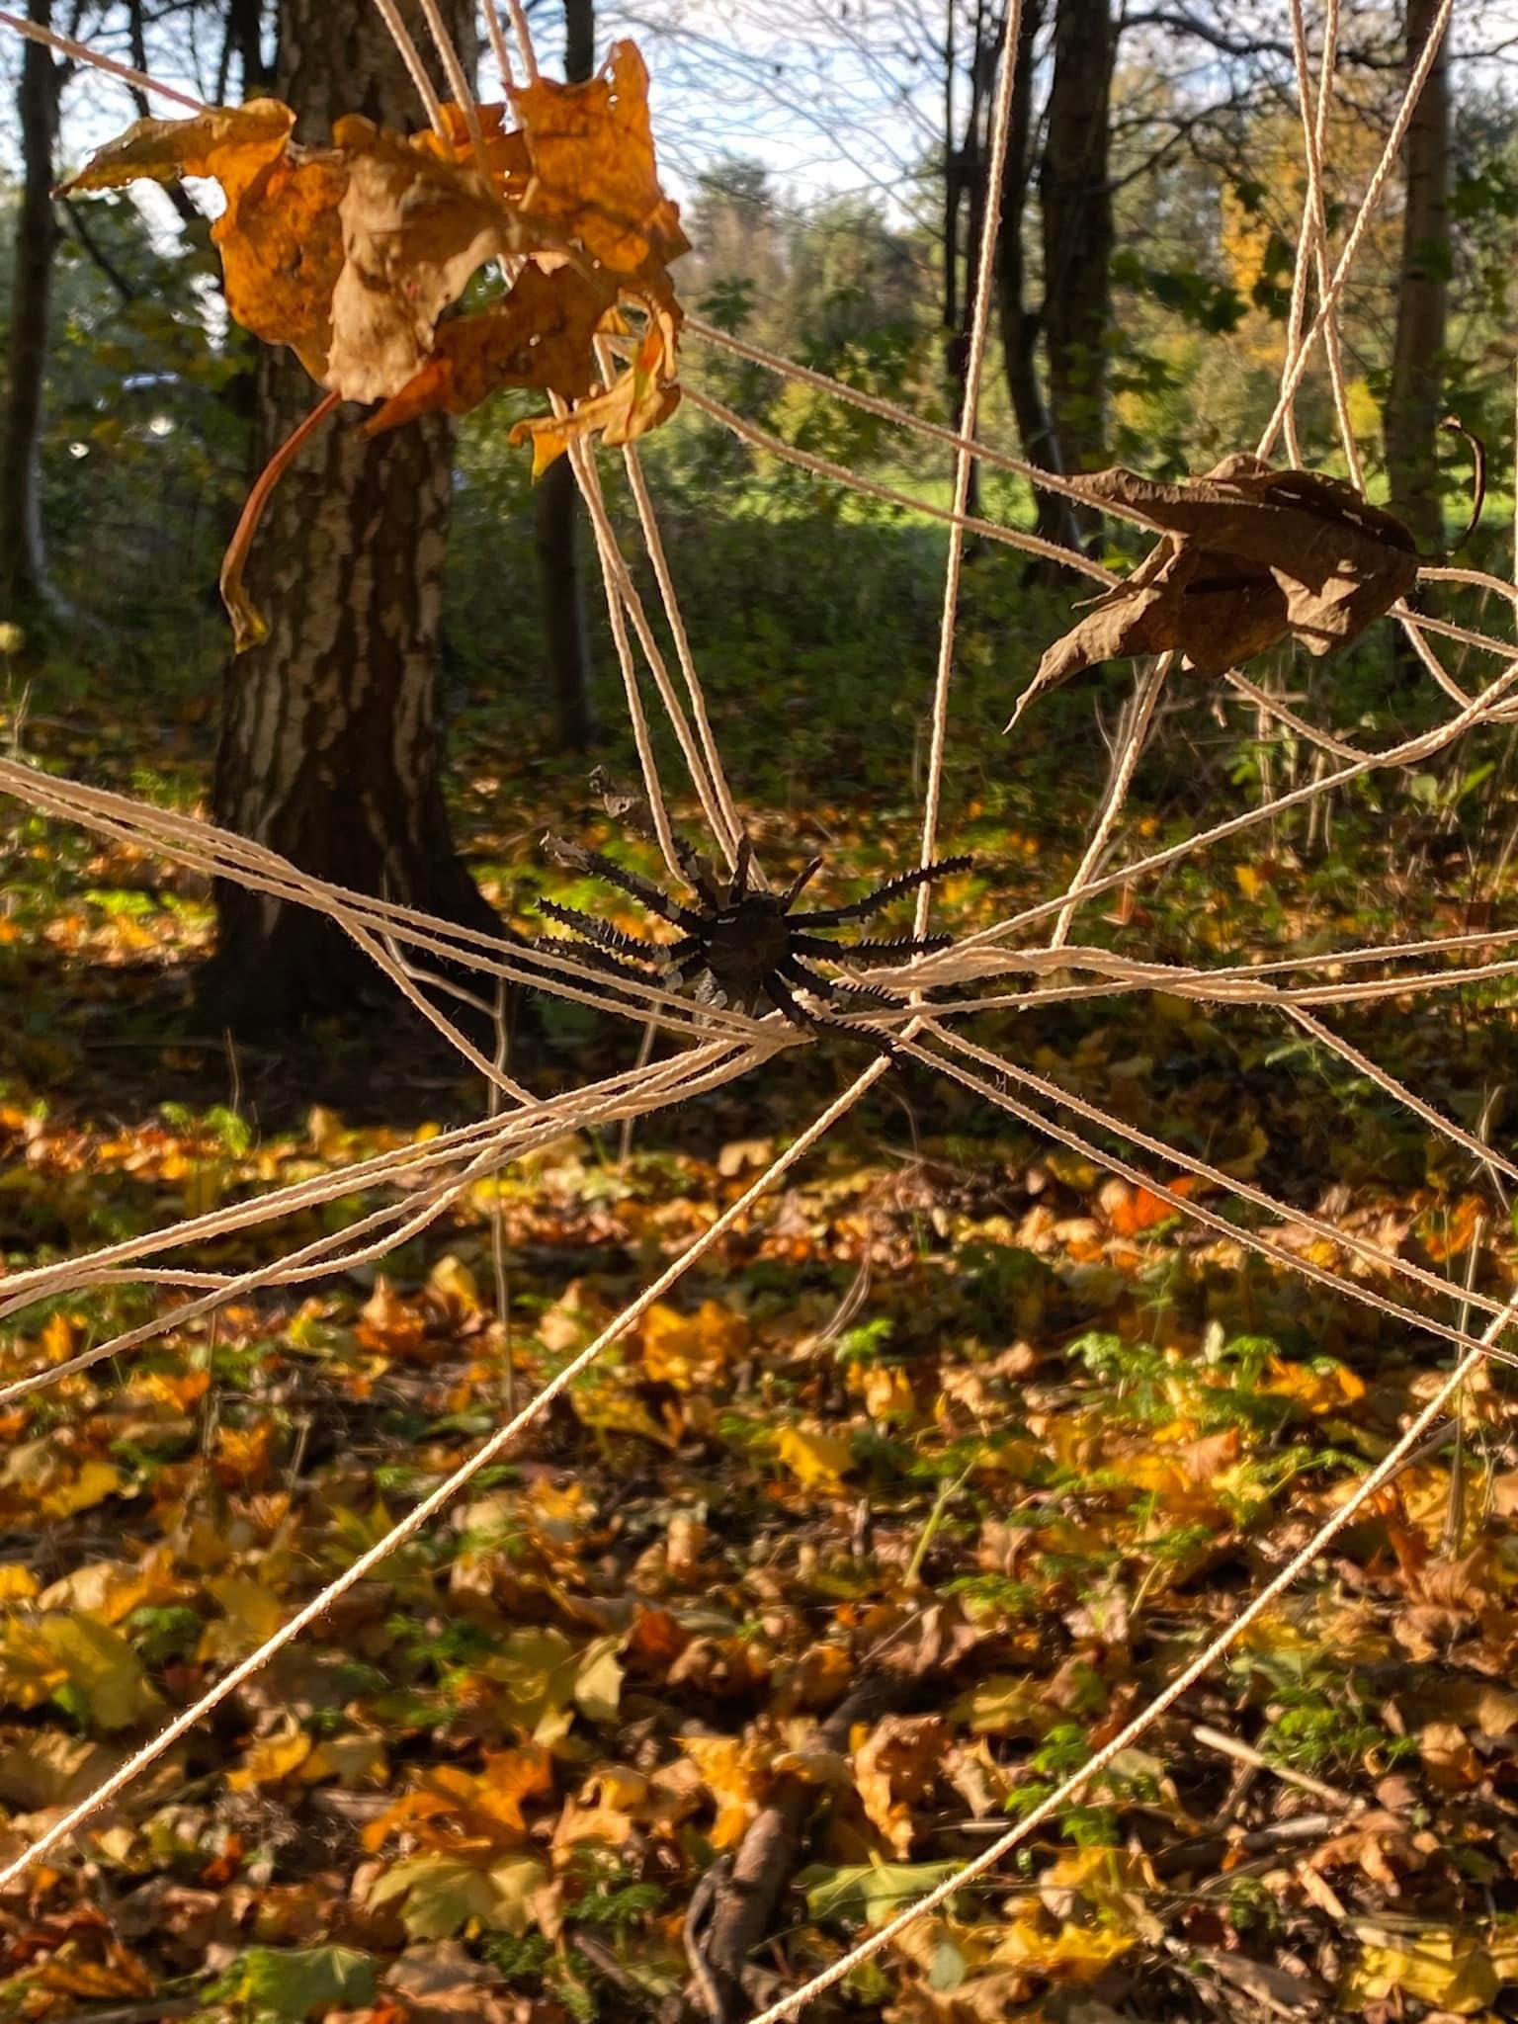
Introduction to the Day's Activities
1
Welcome and Introductions
Safety Rules and Guidelines
2
The day began with a warm welcome and introductions to the forest guides and fellow participants.
Important safety rules and guidelines were discussed to ensure a safe and enjoyable experience for all.
Activity Schedule Overview
Forest Exploration Tips
3
4
A quick overview of the day's activities was presented, building anticipation for the exciting adventures ahead.
Tips on how to observe, respect, and explore the forest environment were shared, encouraging a connection with nature.

Slide 3
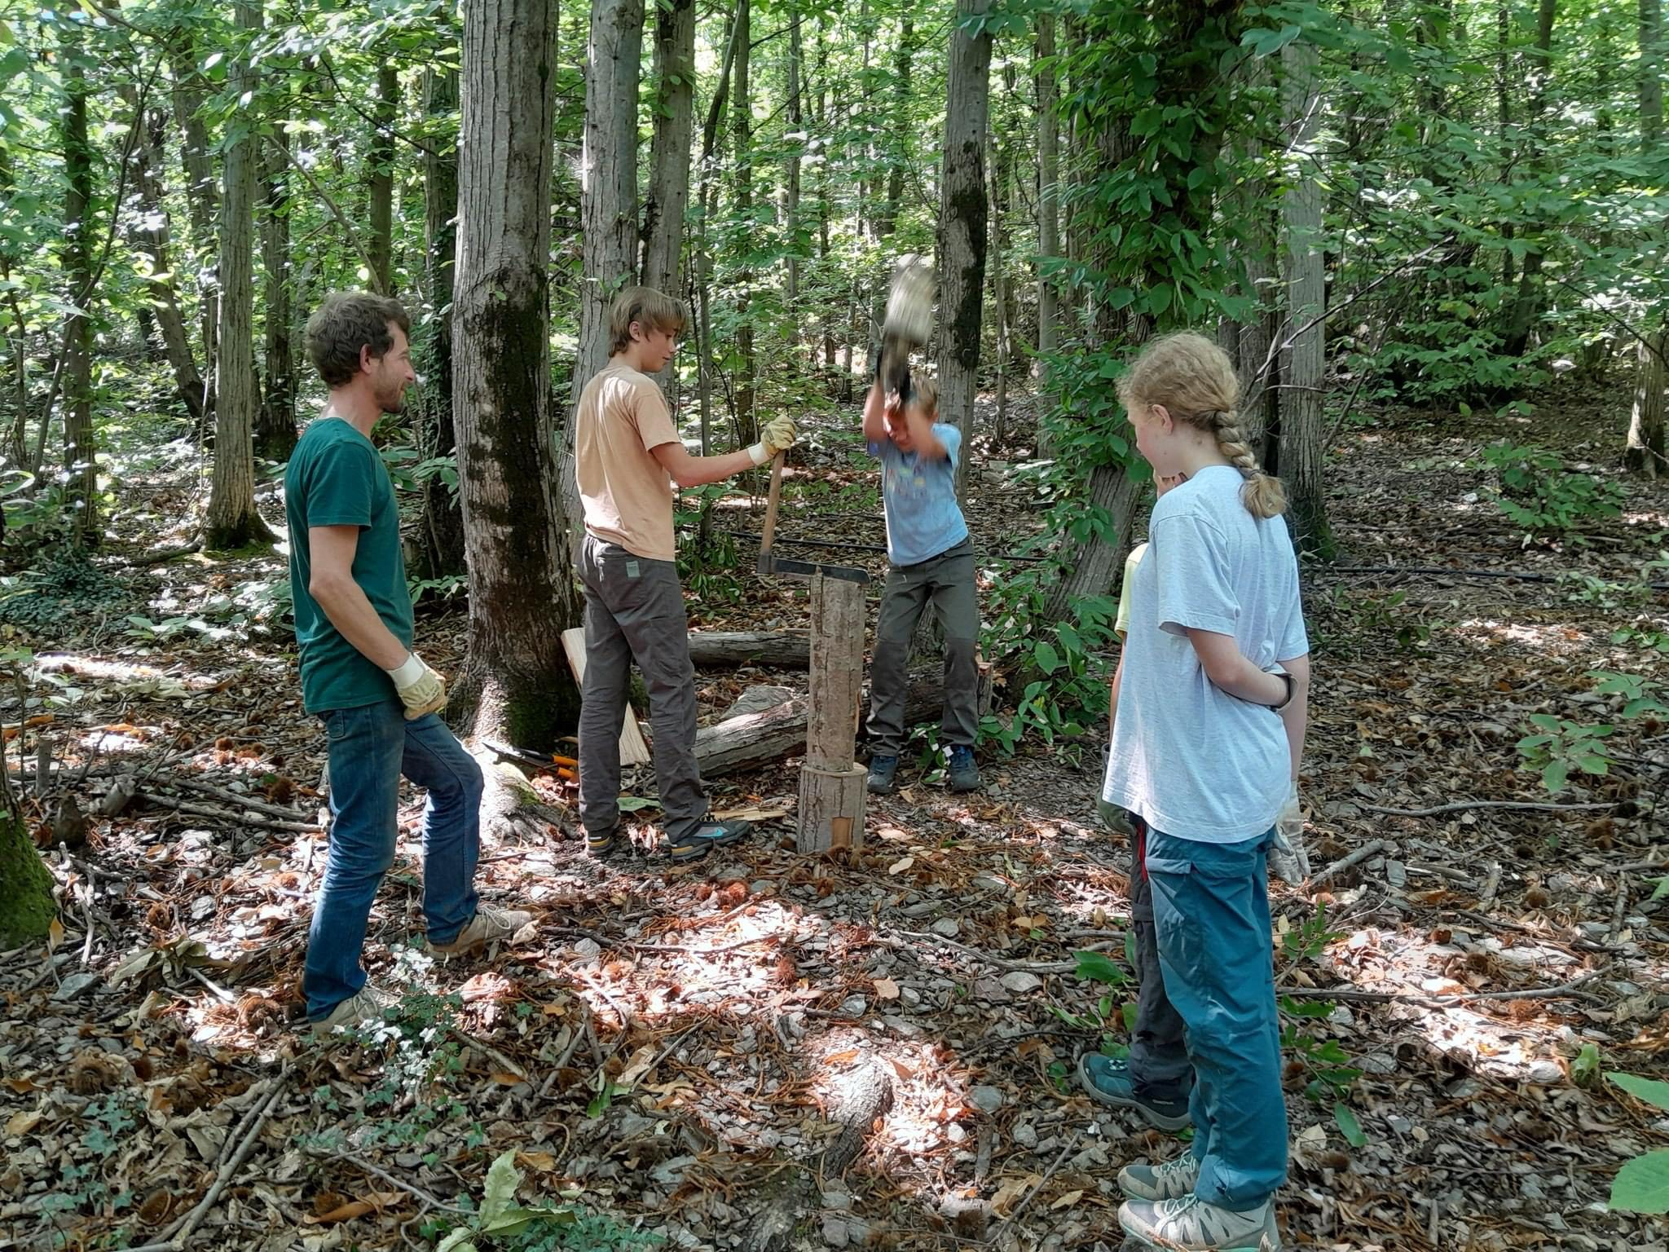
Learning about Forest Animals And Wood
Native Forest Animals
Forest Animal Sounds
Children learnt about common forest animals like squirrels, deer, rabbits, and birds. Their unique characteristics, habitats, and importance were discussed.
Children listened to recordings and learned how to imitate the sounds of forest animals, adding an element of auditory discovery and appreciation.
Animal Tracking and Identification
Wood adventure
A fun activity involved learning how to identify animal tracks and signs. They discovered the clues animals leave behind, like footprints, droppings, and markings.
The children also learnt how to properly cut down a log of wood in order to use for fires.
This was done alongside an adult and for the older realm of children that were teens.

Slide 4
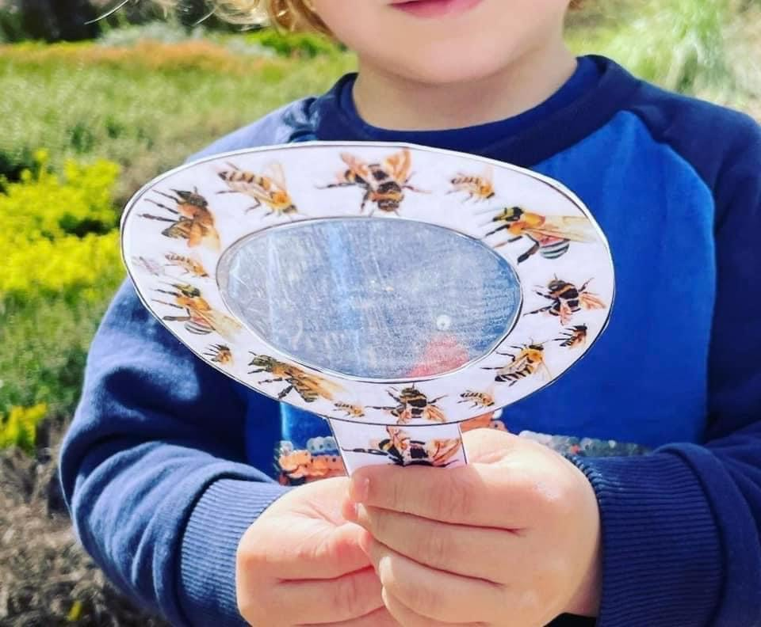
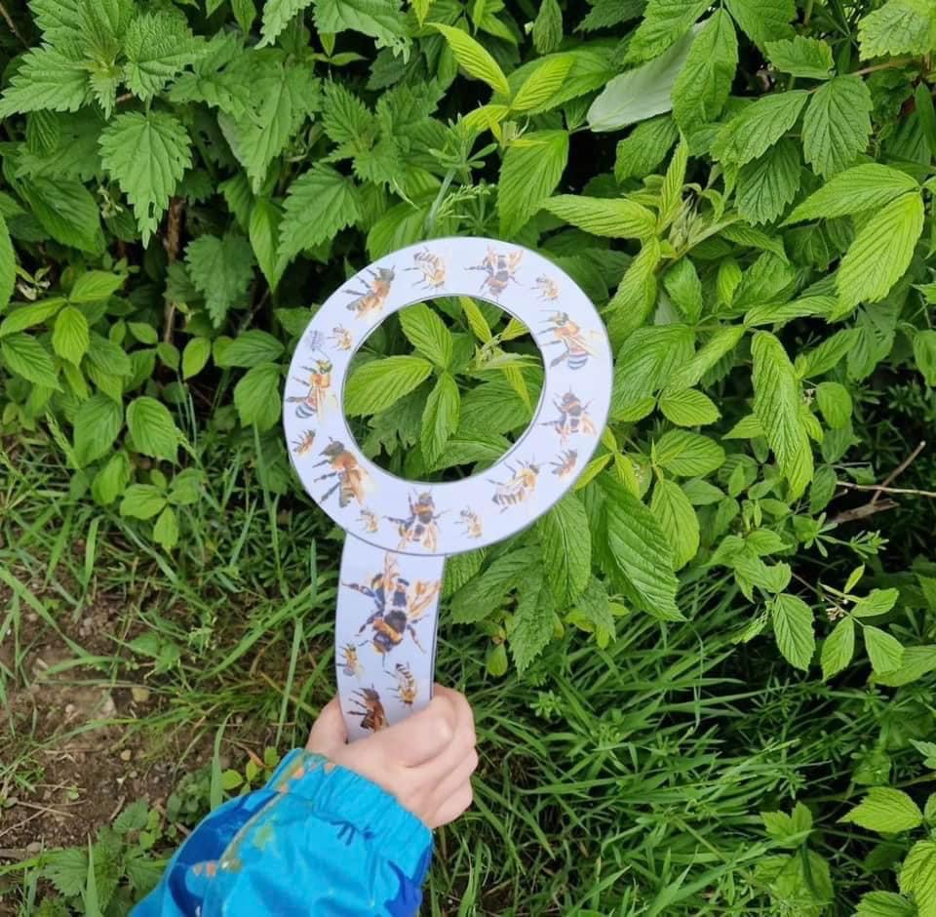
Exploring Bugs and Insects
1
Bug Hunting
Armed with magnifying glasses and bug catchers, the kids embarked on a bug hunt, exploring different areas of the forest.
2
Insect Identification
They learned to identify common insects like butterflies, ladybugs, ants, and beetles, recognizing their unique features.
3
Insect Ecology
The role of insects in the forest ecosystem was discussed, emphasizing their importance for pollination, decomposition, and food chains.

Slide 5
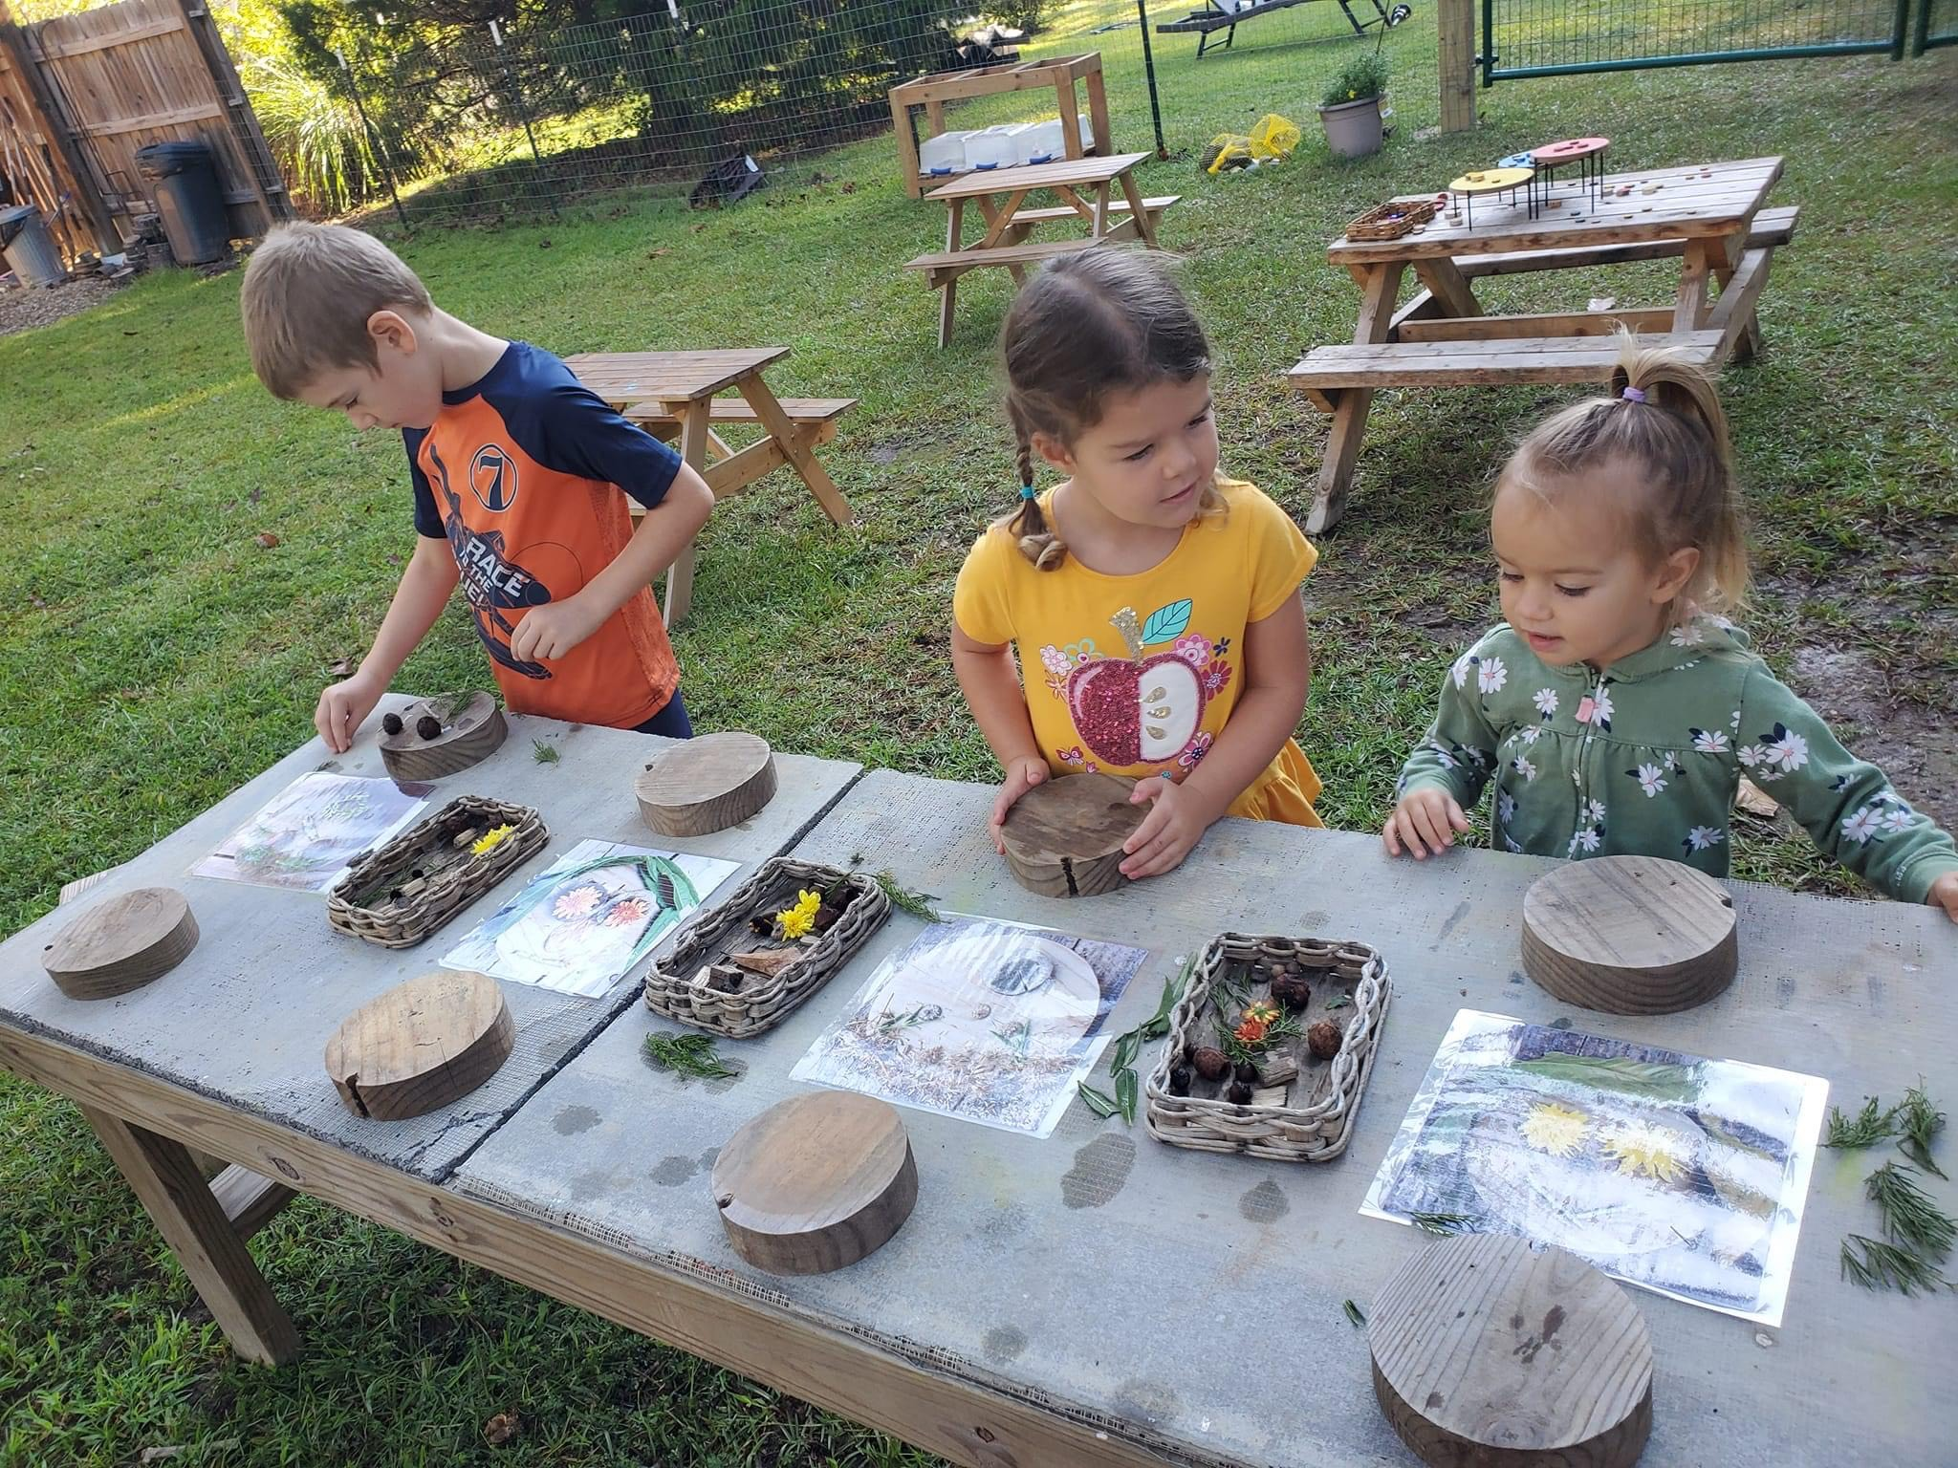
Storytime in the Woods
Forest Folktales
Nature-Inspired Stories
Animal Adventures
A captivating storyteller shares traditional forest folktales, bringing the magical world of the forest to life through stories.
The stories feature forest animals as characters, teaching valuable lessons about friendship, courage, and respect for nature.
The stories highlight the beauty, wonder, and importance of the forest, inspiring a love and appreciation for the natural world.

Slide 6
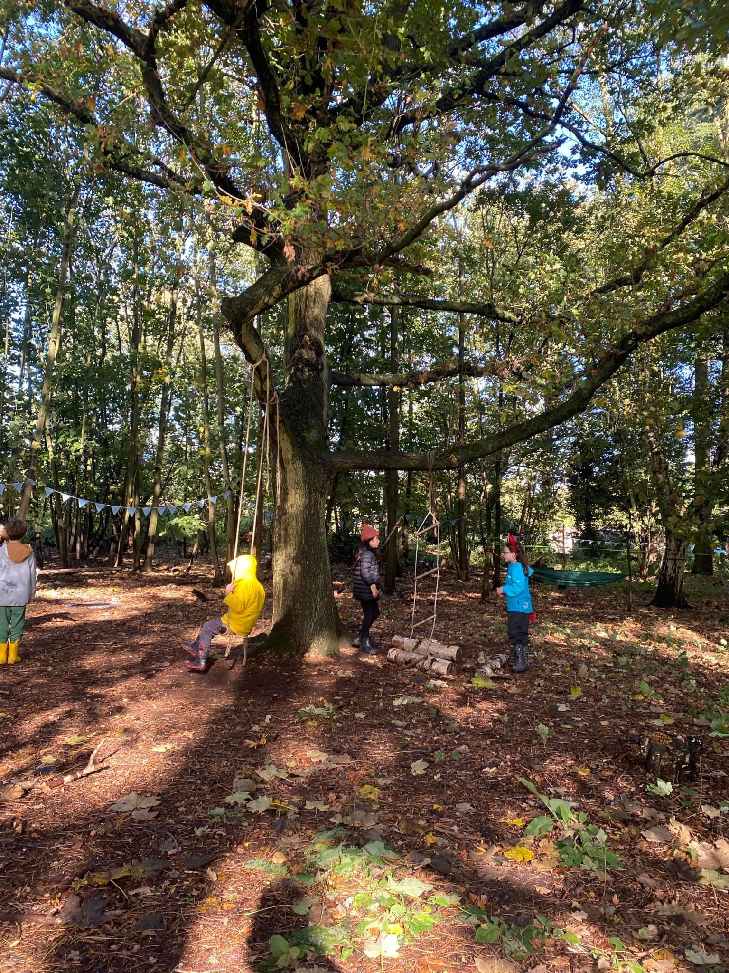



Outdoor Scavenger Hunt
Nature Clues
Children followed clues that led them to different parts of the forest, searching for natural objects and
identifying them.
Teamwork and Exploration
The scavenger hunt encouraged teamwork and exploration, fostering collaboration and a sense of discovery.
Prizes and Rewards
Upon completion of the scavenger hunt, children received small prizes and rewards, celebrating their effort
and accomplishment.

Slide 7
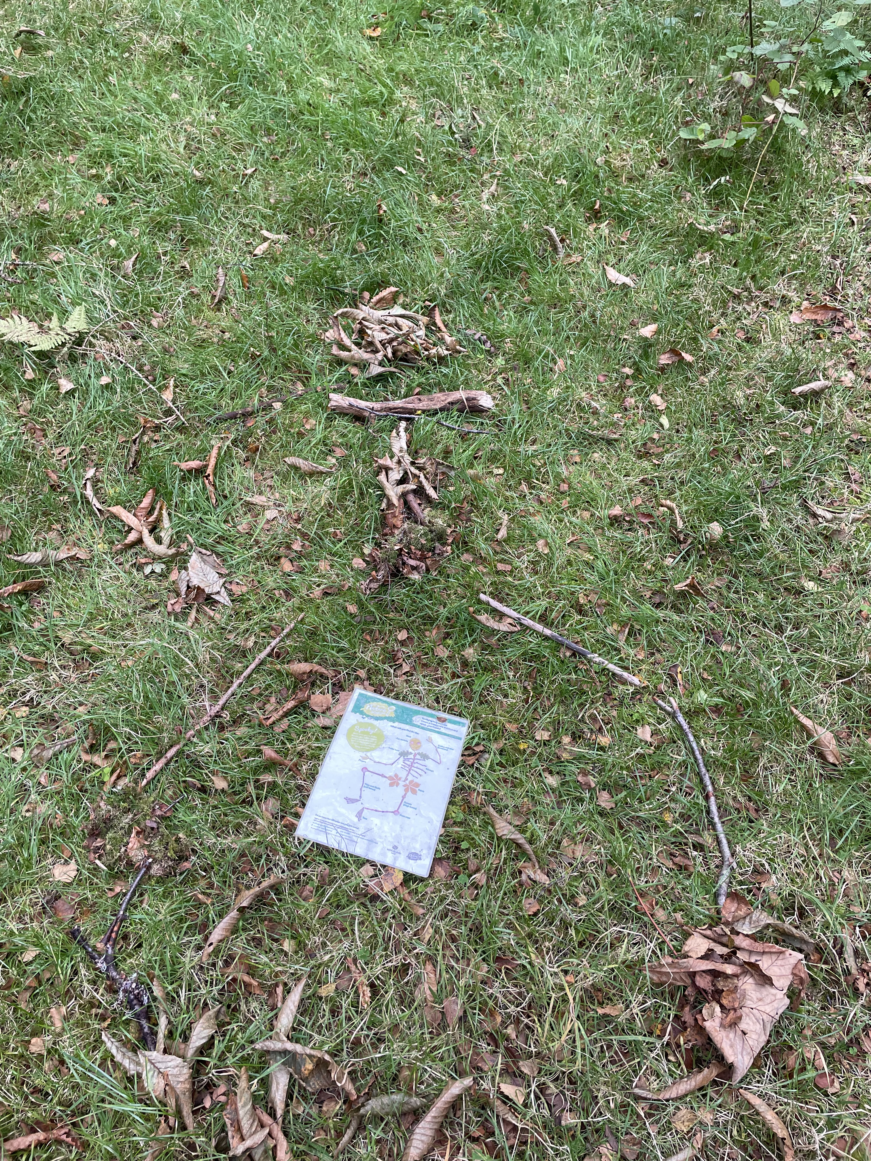
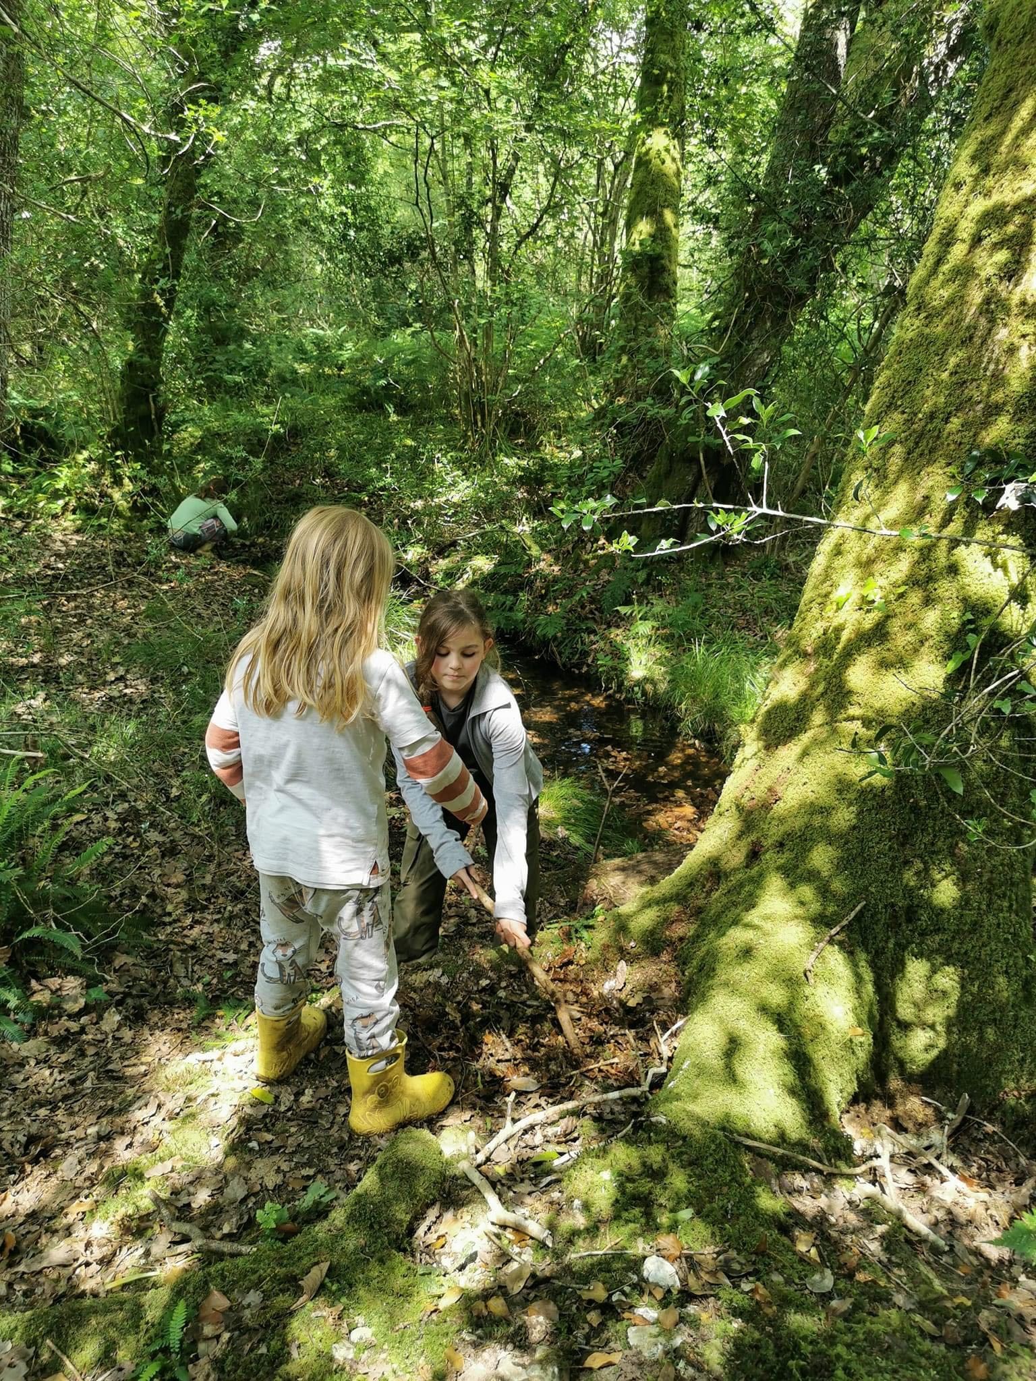
Arts and Crafts with Natural Materials
Creativity and Imagination
This activity encouraged creativity and imagination, allowing the children to express their artistic talents using natural elements.
Nature-Inspired Crafts
Children used natural materials like leaves, sticks, stones, and flowers to create beautiful nature-inspired crafts.

Slide 8
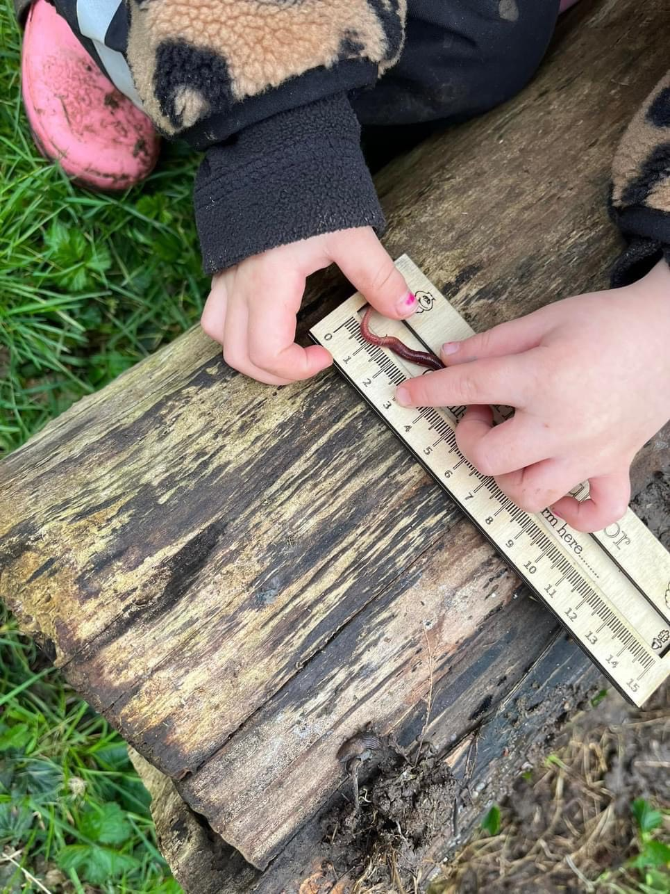
Guided Nature Walk
Forest Exploration
A guided nature walk through the forest allowed children to observe and learn about various plants, trees, and animal habitats.
Nature Awareness
They learnt about the interconnectedness of the forest ecosystem, understanding the roles of different species and their importance.
Environmental Appreciation
The walk fostered a deep appreciation for the beauty, fragility, and importance of the forest, promoting responsible environmental practices.

Slide 9

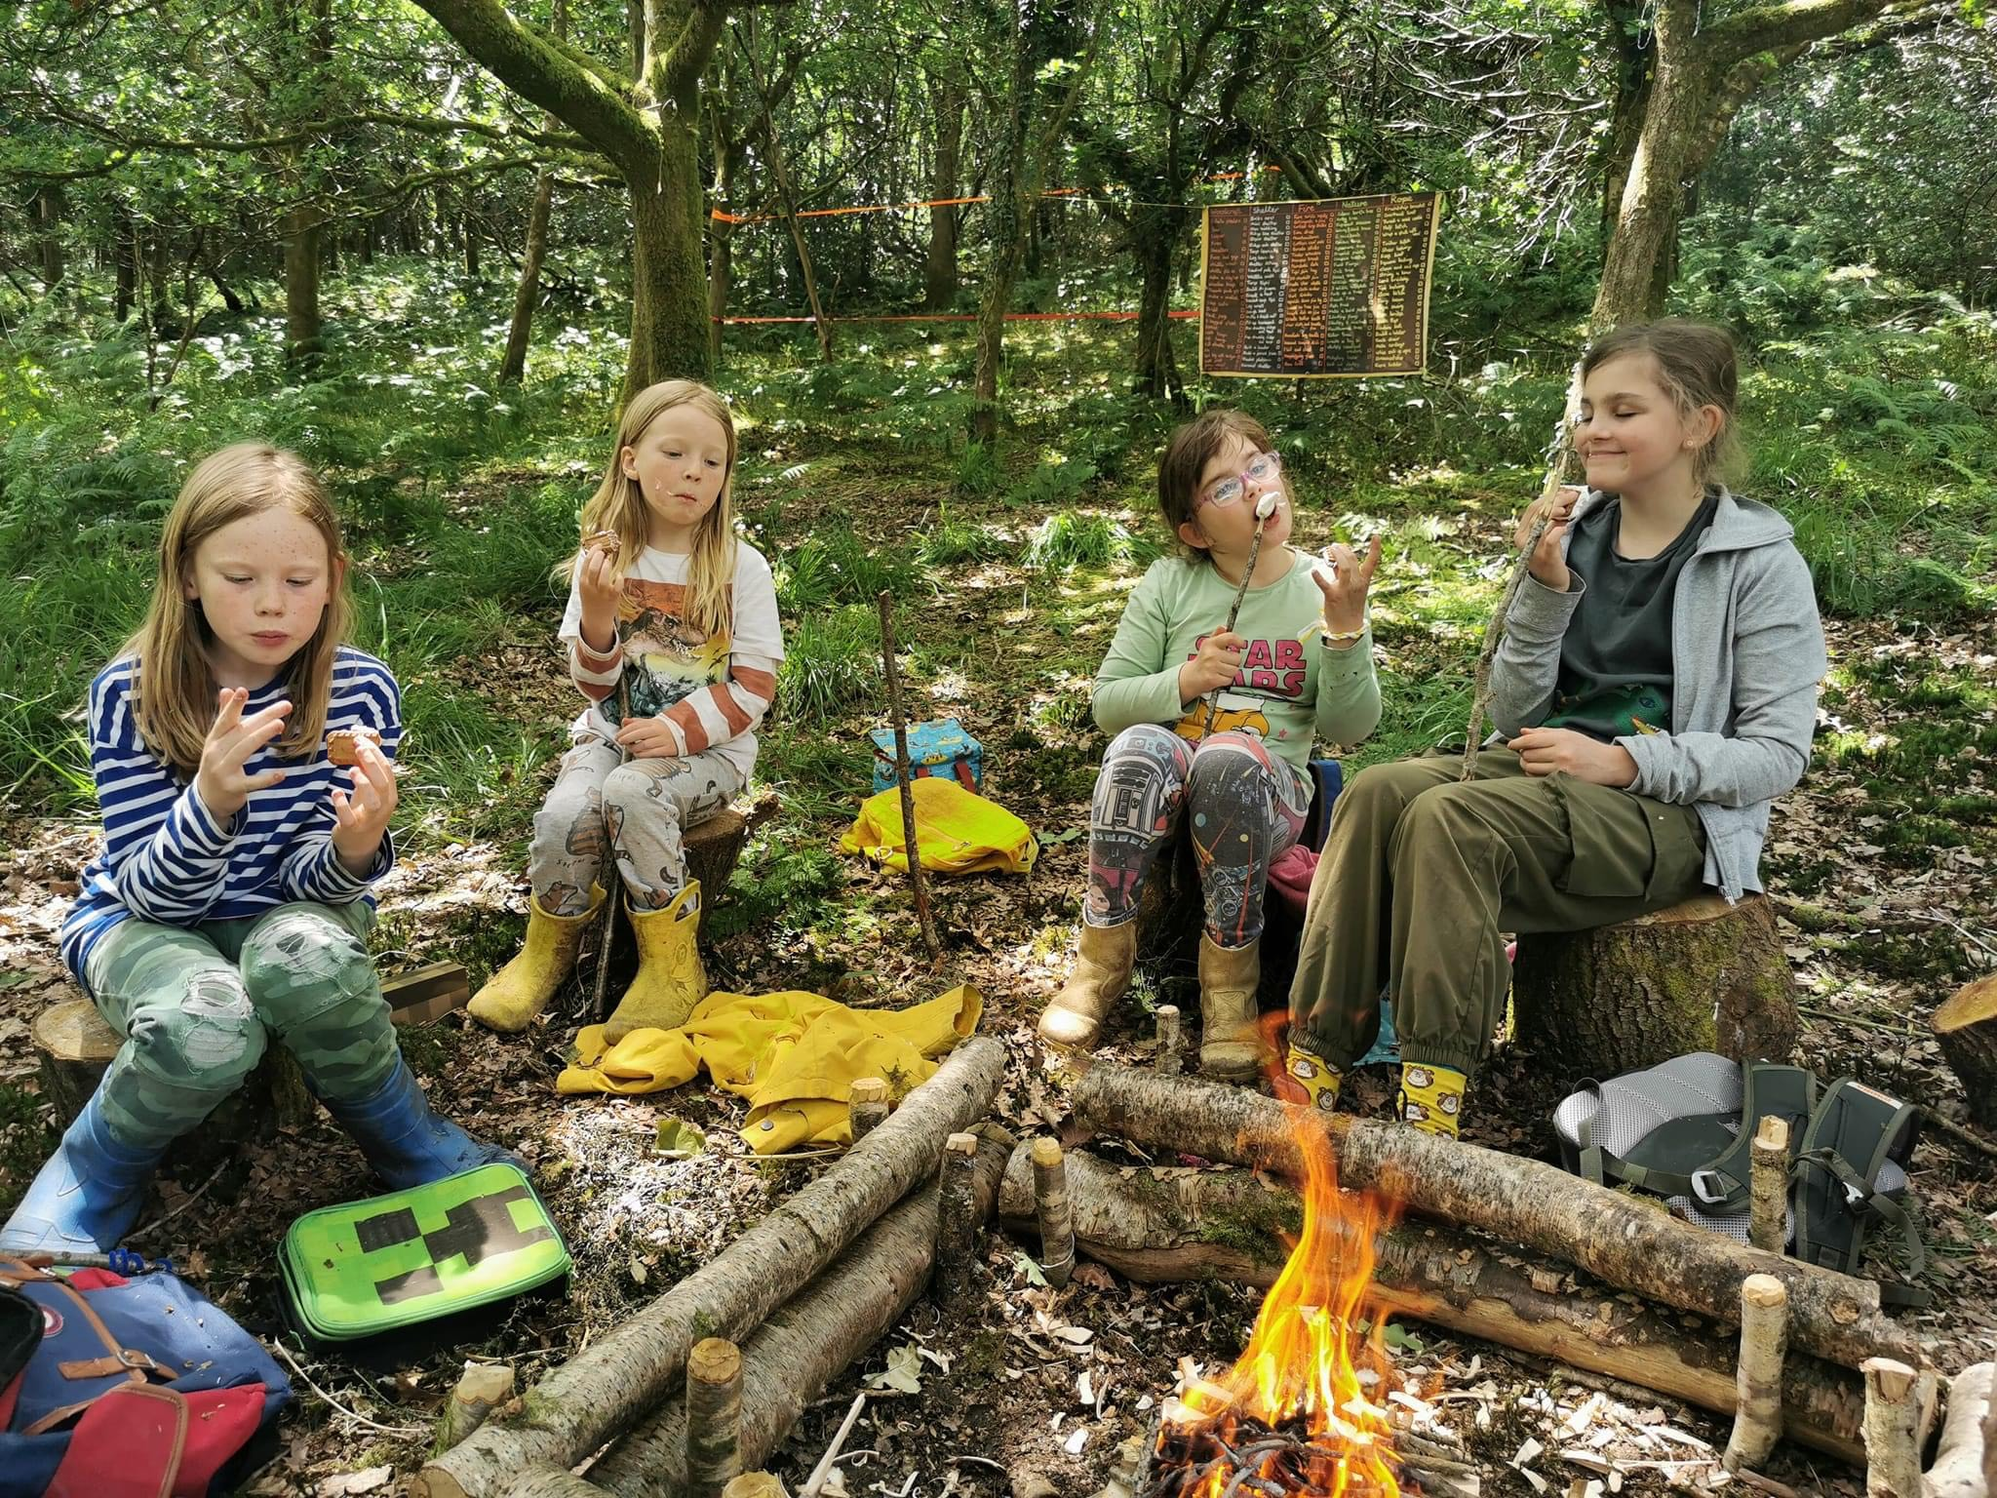


Campfire Sing-along and S'mores
Campfire Sing-along
The day concluded with a cozy campfire sing-along, where children enjoyed singing traditional campfire songs and sharing stories.
S'mores Treat
A delicious treat of s'mores was enjoyed by all, with the campfire providing a warm and inviting atmosphere for sharing stories and laughter.
Musical Entertainment
The native American Indian flute was used to promote cultural diversity in learning.

Slide 10
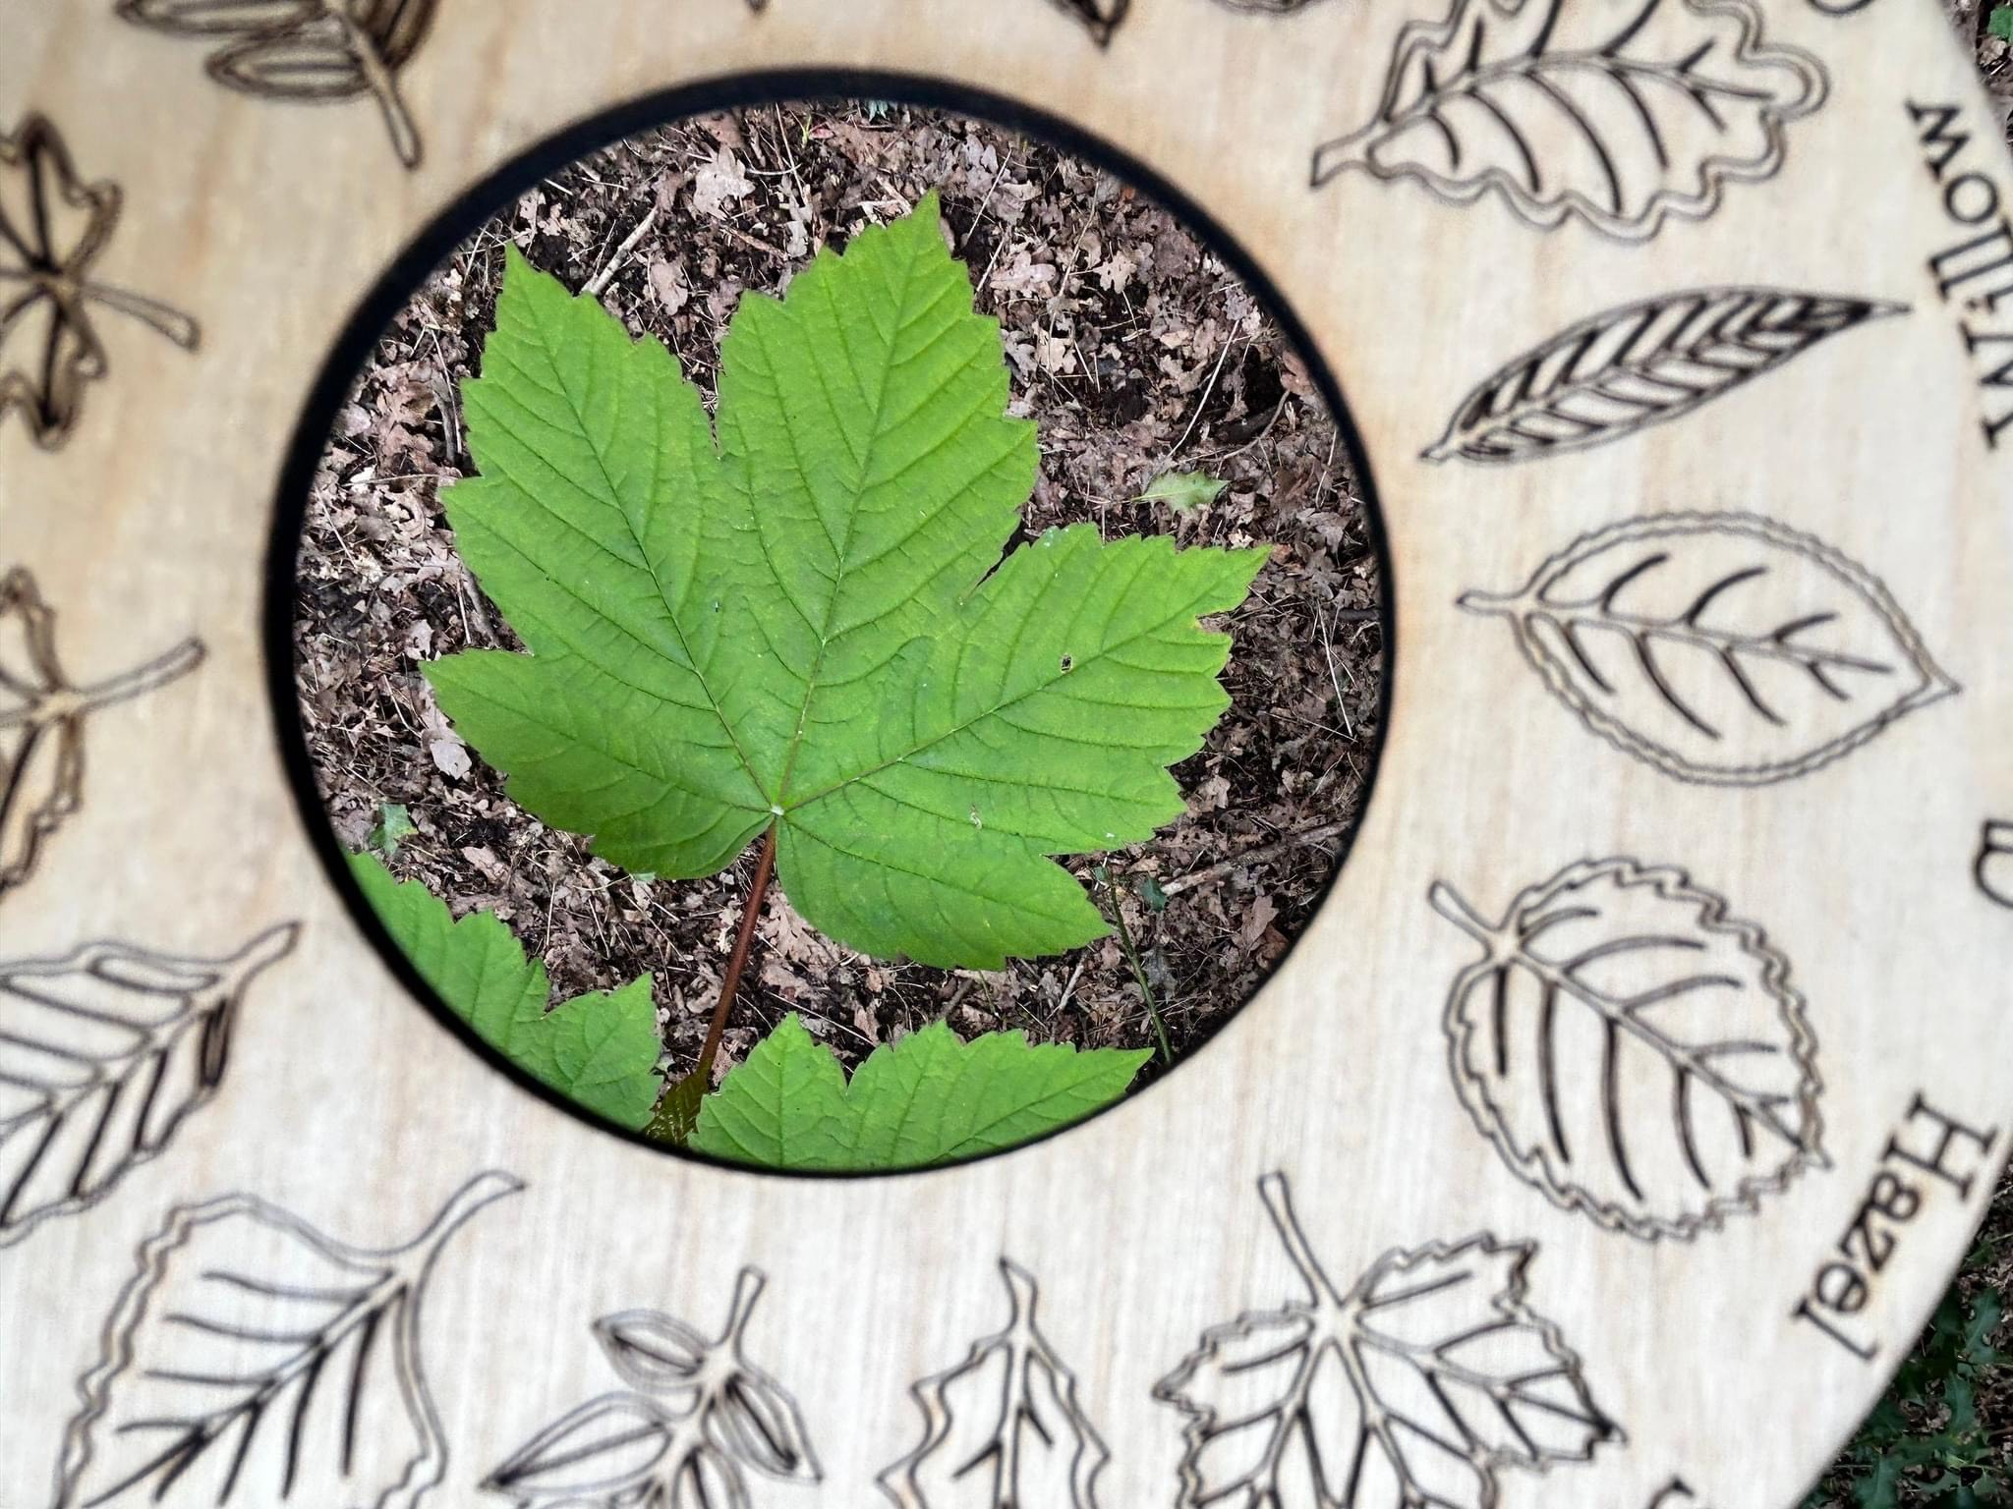
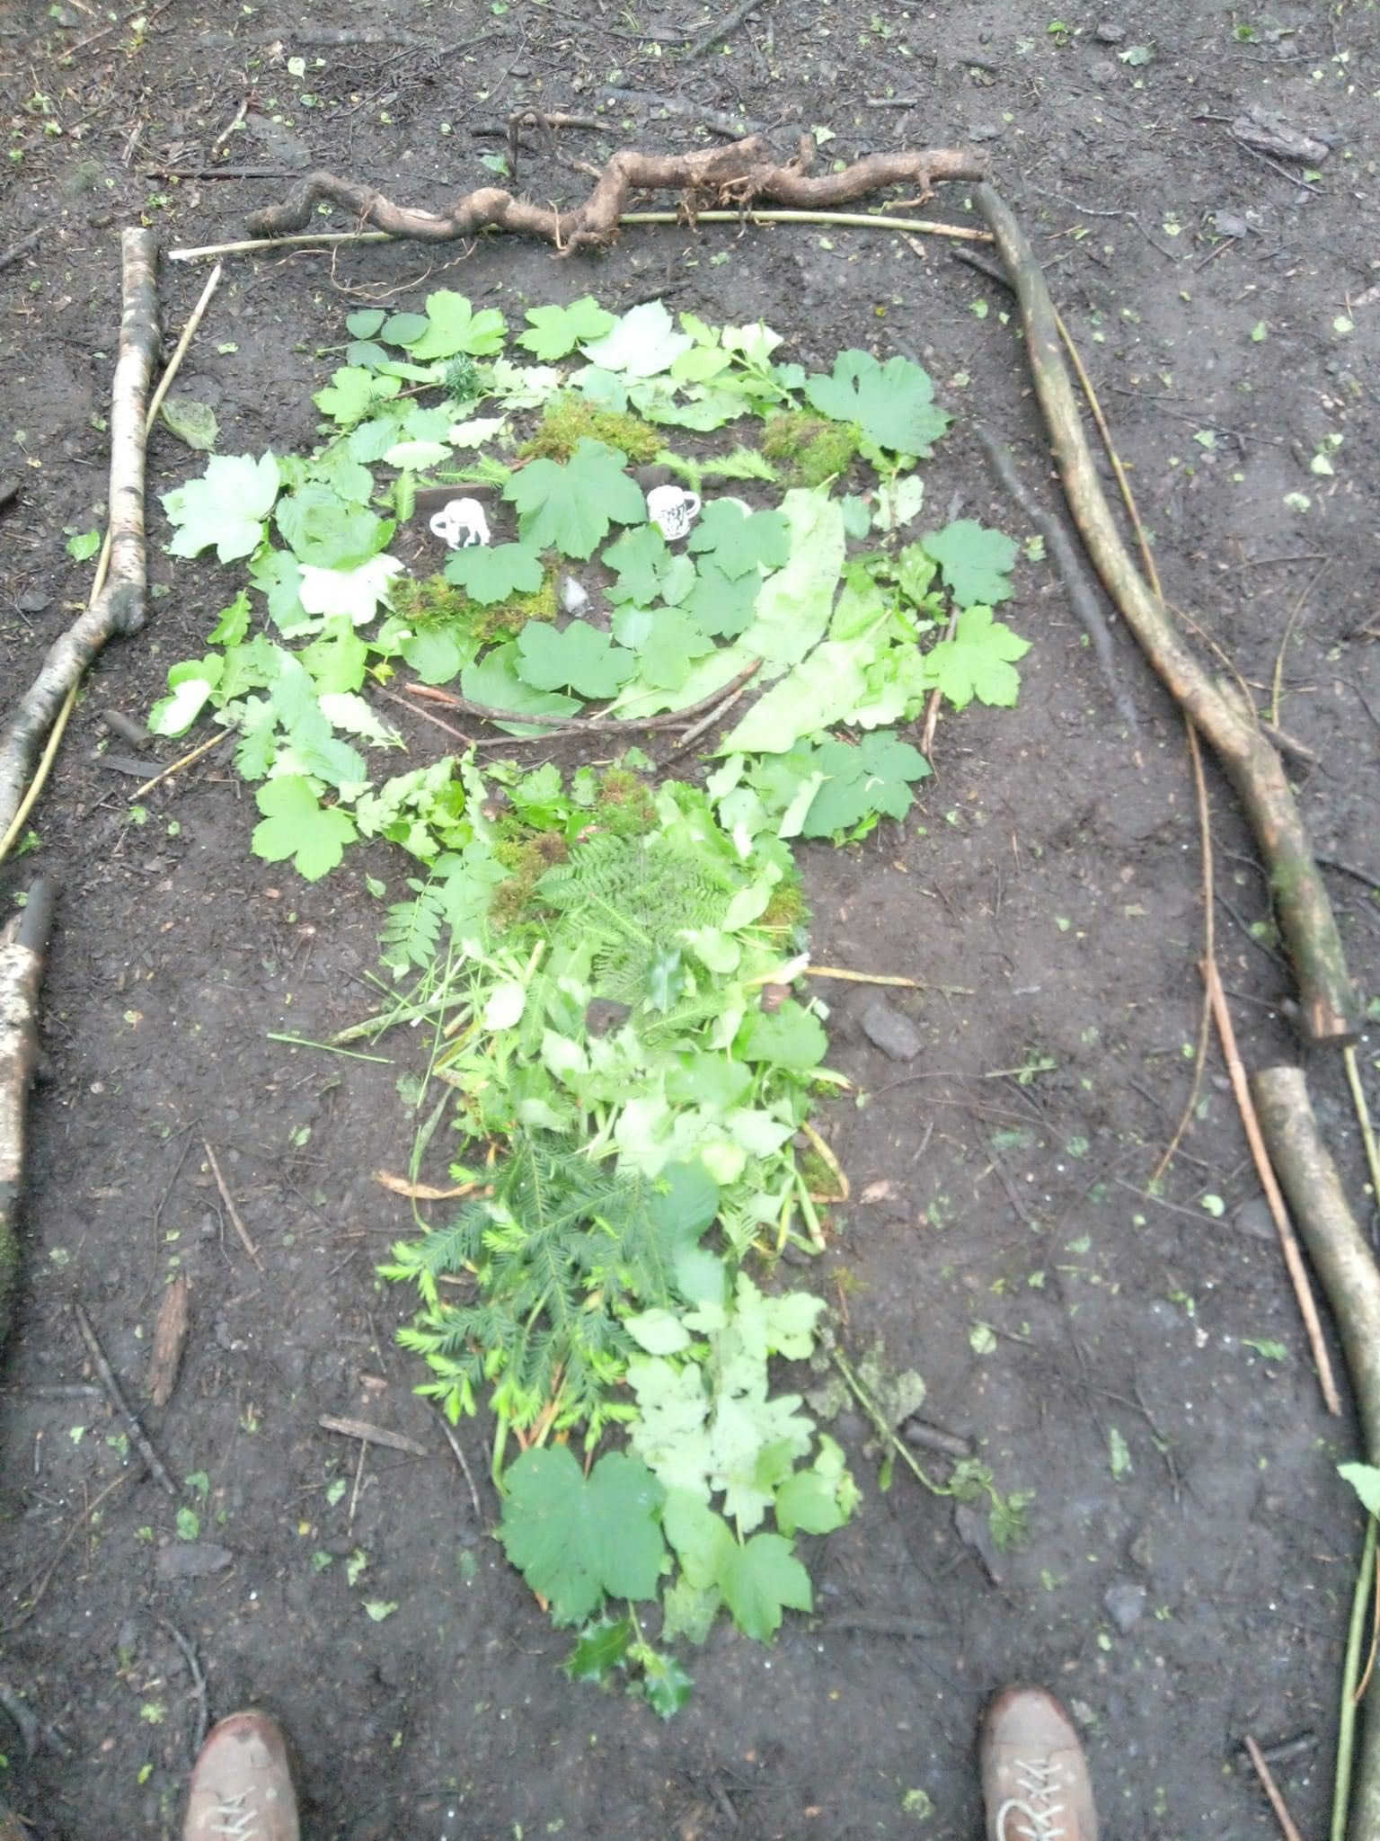
Closing Remarks and Feedback
Gratitude and Appreciation
Feedback Collection
The day ended with expressions of gratitude for the children's participation, acknowledging their enthusiasm and learning.
A short feedback session was conducted to gather feedback on the activities, ensuring future events met the needs and interests of the children.
Farewell and Goodbyes
The day concluded with a farewell and goodbyes, leaving the children with positive memories of their forest adventure.

